Slide 1
Visualization, Analysis of School Data & Predicting average Enrolment of students in coming years using ARIMA model. PREPARED BY: REEKA HAZARIKA

Slide 2
Objectives:
Which Curriculum Schools are the most prominent in Dubai, in terms of Fees, Enrolment, Rating and Number.
Predicting average Enrolment of students in coming years using ARIMA model.

Slide 3

STEP 1 DATA PREPARATION
Raw Data

Slide 4
Importing School Data into R, Joining Dataset and Cleaning Data

Slide 5

STEP 2 Data Visualization

Slide 6

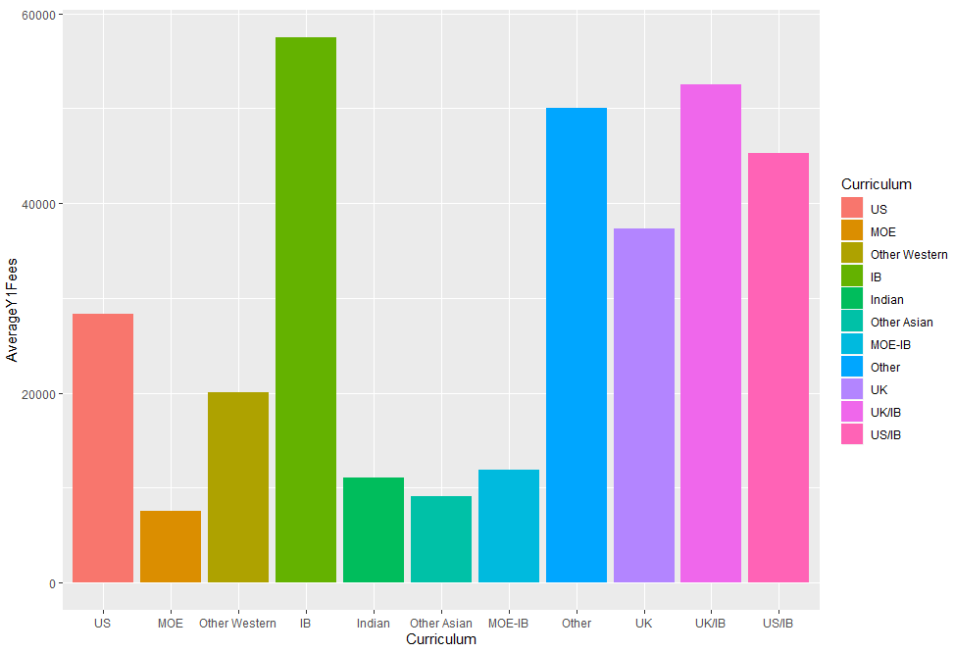

Slide 7

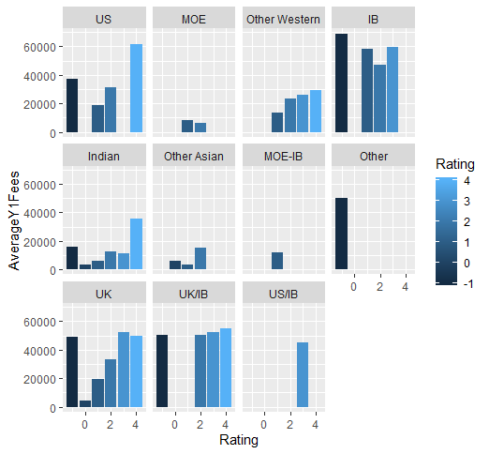
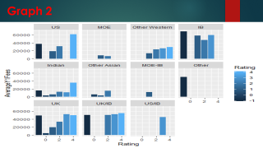
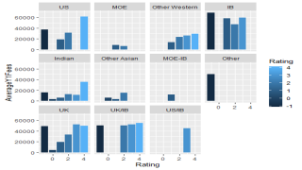

Slide 8

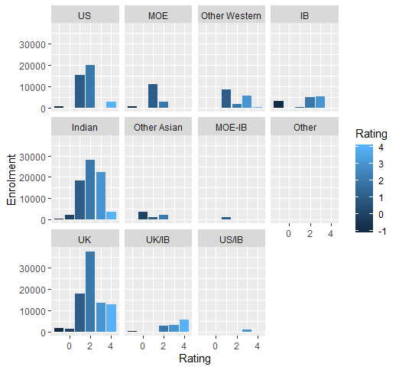

Slide 9
Step 3 Data Analysis: For Analysis we have taken Year 1 data.
Graph 3
Rating vs Enrolment Year 1 for all Curriculum
Graph 1
Curriculum vs Average Fees Year 1
Graph 2
Rating vs Average Fees Year 1 for all Curriculum
As per the graph, IB curriculum schools have the highest Average Fees for Year 1 which is around 58,000 AED per annum.
The 2nd highest are the UK/IB curriculum schools which are around 52,000 AED per annum.
The Lowest Average Fees for Year 1 are the MOE – Ministry Of Education Schools.
The Average Fees for Newly Established IB Curriculum Schools are the Highest considering all the Curriculum Schools.
Outstanding and Very Good rating UK/IB & UK Curriculum Schools have almost the same Fee Structure, between 50,000-55,000 AED per annum.
UK Curriculum Schools with Good Rating have the Highest Enrolment , around 45,000 and next is Indian Curriculum Schools, around 29,000.
Outstanding Rating Schools have the lowest Enrolment in comparison to Very Good and Good Rating Schools.

Slide 10
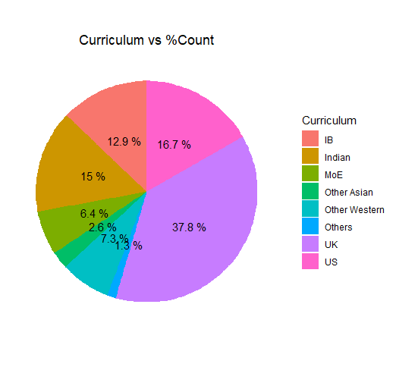
Graph 4: Curriculum vs %Count of Schools
As per the Pie Chart, approx. 38% of the schools have UK Curriculum, which is much higher in comparison to the other Curriculum Schools.

Slide 11
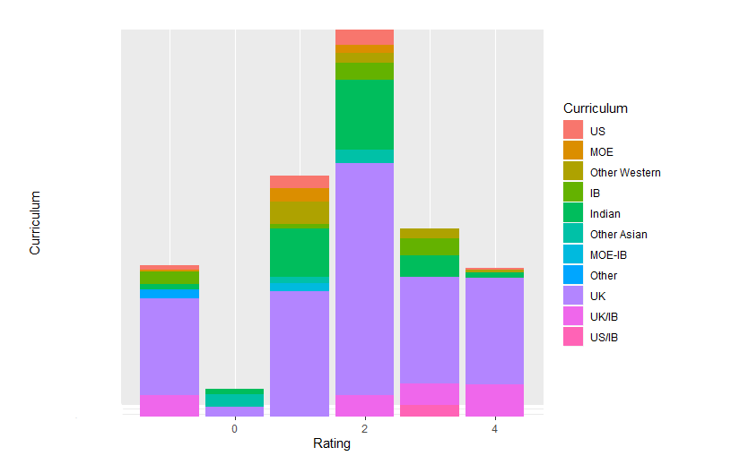
Graph 5:Rating vs Curriculum
As per the Graph, for Outstanding (4), Very Good (3), Good (2) Ratings, UK Curriculum Schools are higher compared to the other Curriculum Schools.

Slide 12
Conclusion:
UK Curriculum Schools are the most prominent in Dubai, in terms of :
Number of Students - Is the highest approx. 45,000 in comparison to the other Curriculum Schools.
Number of Schools – Approx. 38% of the schools have UK Curriculum, which is much higher in comparison to the other Curriculum Schools.
Rating - Ratings of UK Curriculum Schools are much higher compared to the other Curriculum Schools.
Fees –
The Average Fees for Year 1 for UK Curriculum is approx. 38,000 AED per annum which is much less in comparison to Schools providing only IB Curriculum which is 58,000 AED per annum.
Outstanding and Very Good rating UK Curriculum Schools have almost the same Average Fee Structure for Year 1 which is approx. 52,000 AED per annum.
Good Rating UK Curriculum Schools have an Average Fee for Year 1, approx. 31,000 AED.

Slide 13
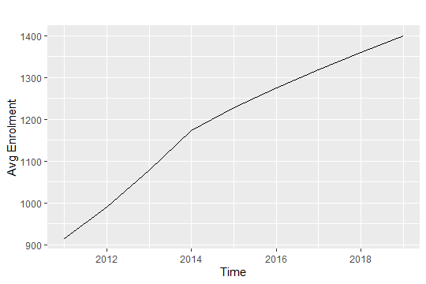
Data Visualization in Time Series:
Data transformed into Time Series:
school_ts <- ts(d1, start = c(2011),end = c(2019),frequency = 1)
autoplot(school_ts)+xlab("Time")+ylab("Avg Enrolment")
Trend : There is a trend.
Seasonality : no seasonality.
Data is non stationary

Slide 14


Training and test datasets
Dividing the Dataset into 2 sets, Training dataset and Test dataset, and using the training dataset to forecast the test dataset. Training dataset - all data except last 1 year
train <- window(school_ts, start=c(2011), end=c(2018)) # training dataset - all data except last six months
Test data - just the last 1 year
test <- window(school_ts, start=c(2019), end=c(2019))

Slide 15
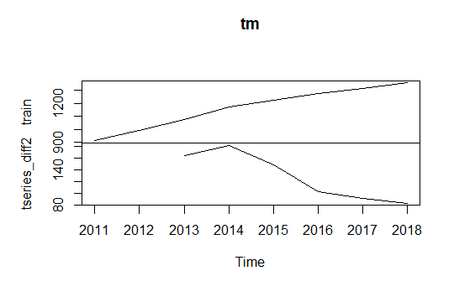
Model Building and Model Identification: nsdiffs(school_ts) #0 ndiffs(school_ts) #2 Model is non seasonal and non stationary, we will build ARIMA model, differencing will be twice i.e. d=2
Using a differencing to stationarize the data
tseries_diff1 <- diff(train, lag = 1)
tm <- cbind(train, tseries_diff1)
head(tm)
tseries_diff2 <- diff(train, lag = 2)
tm <- cbind(train, tseries_diff2)
head(tm)
plot.ts(tm)

Slide 16
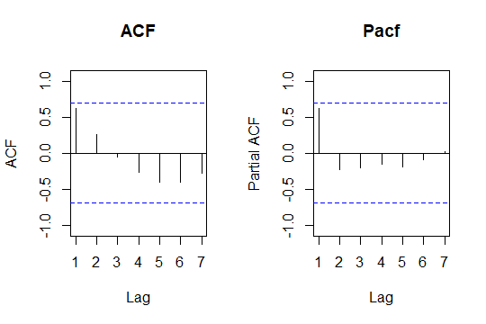
Plotting ACF and PACF graphs to check the order of p(AR) and q(MA)
par(mfrow=c(1,2))
Acf(train,main="ACF")
Pacf(train,main="Pacf")
Both ACF and PACF is 0, means there is no correlation, ACF shows there is no correlation between present value of time series and the past value and PACF shows there is no correlation of residuals.

Slide 17
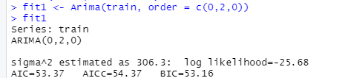
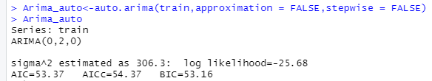
Building ARIMA Model: c(0,2,0)
fit1 <- Arima(train, order = c(0,2,0))
fit1 ARIMA model with c(0,2,0) order is the best fitted model with the AIC value of 53.37.
Arima_auto<-auto.arima(train,approximation = FALSE,stepwise = FALSE)
The auto.arima function give c(0,2,0) order model as the best fitted model with AIC=53.37.

Slide 18
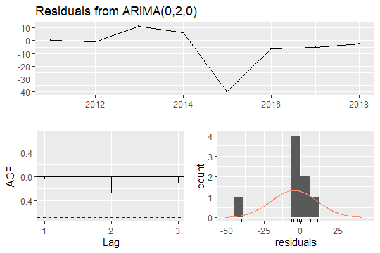
Checking Residual: checkresiduals(fit1)
Residuals are uncorrelated and normally distributed

Slide 19
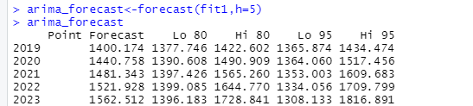
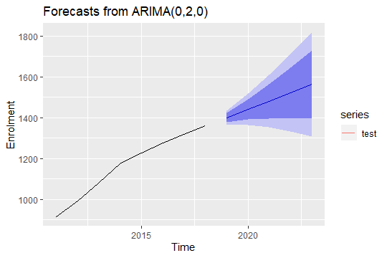
Forecast and plot of Forecast for next 5 years:
arima_forecast<-forecast(fit1,h=5)
autoplot(arima_forecast)+xlab("Time")+ylab("Enrolment")+autolayer(test)
Forecast Analysis:
As per the Test dataset, the average enrolment of students for 2019 is 1400.063, and the forecasted average enrolment of students for 2019 is 1400.174.The 95% prediction interval is between 1365.874 and 1434.474. Hence we observe that for the year 2019 the difference between actual and forecasted value(=error) is very less, i.e. 0.111.

Slide 20

Accuracy of Forecast:
accuracy(arima_forecast)
ME: Mean Error – Average difference between actual and forecasted value is -4.6.
RMSE: Root Mean Squared Error = 15.1.
MAE: Mean Absolute Error=4.36, i.e. the average of the difference between actual and forecasted value is 9.1.
MPE: Mean Percentage Error - percentage error by which forecasts of a model differ from actual value is -35%
MAPE: Mean Absolute Percentage Error = 0.8%, the percentage of the error compared to the actual value.
MASE: Mean Absolute Scaled Error =0.14, current model is approx 5 times as good as the naïve model.
ACF1: Autocorrelation, it is a measure of how much is the current value influenced by the previous values in a time series = -0.05

